Slide 1
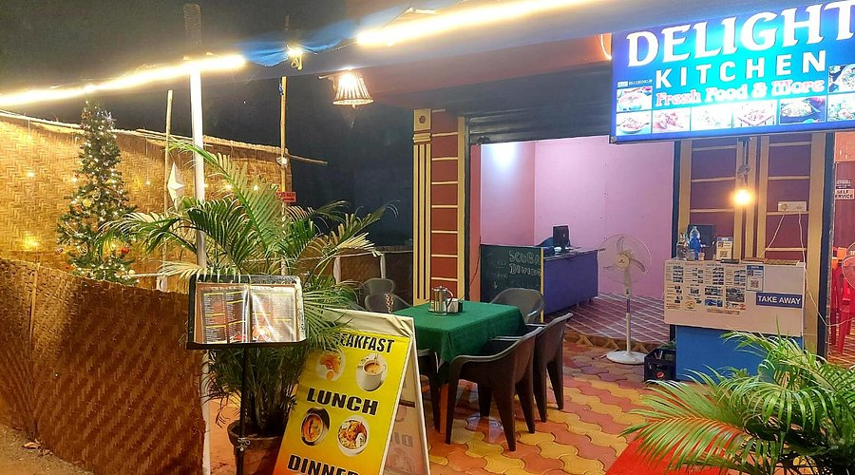
DELIGHT KITCHEN
Presented By : -
Gaurav Sapkale
Shivam Tripathi

Slide 2
Introduction
The main purpose of developing the “Restaurant Management System” is to manage and maintain the functionalities that are needed in proper workflow and smooth running of the restaurants.
This system provides the flow about how the services are being managed by different staff person in the restaurant in an efficient manner whenever a person orders a cuisine.
Whenever a staff person with a specific role logs into the system he could see the status and pending services that are need to be delivered by him based upon his role. In this way, each staff person performs his role and efficiently services the customer.

Slide 3
Technology Used
We have used Java Spring Boot based and MySql database as backend and React JS as Frontend in our Project.
Spring Boot :–
Spring Boot is an open source Java-based framework used to build stand-alone and production ready spring applications. It is a project that is built on the top of the Spring Framework. The main goal of the Spring Boot framework is that it provides an easier and faster way to set up, configure, and run both simple and web-based applications thereby reduce overall development time and increase efficiency
MySql :–
MySql is a relational database management system based on Structured Query Language. The application is used for a wide range of purposes, including data warehousing, e-commerce, logging applications, etc. The main purpose for using for web database.

Slide 4
Technology Used
React :–
React is an open-source JavaScript library that is used for building user interfaces specifically for single-page applications. It’s used for handling the view layer for web and mobile apps. It also allows developers to create large web applications that can change data, without reloading the page. The main purpose of React is to be fast, scalable, and simple.

Slide 5
Application Functions
The application provides efficient way to service the visited customers right from order management to bill management.
01
The application provides easy interface so that different staff person can easily log in the system and do their respective jobs.
02
03
The application provides some privileges to specific person(admin) who can add a new person for specific role in the restaurant , who is seeking job.
04
The application also comprises of updating, deleting, creating new cuisines under a specific category to a specific role based person.
05
Common Dashboard for restaurant staff which shows the revenue generated a day, a day before and week

Slide 6
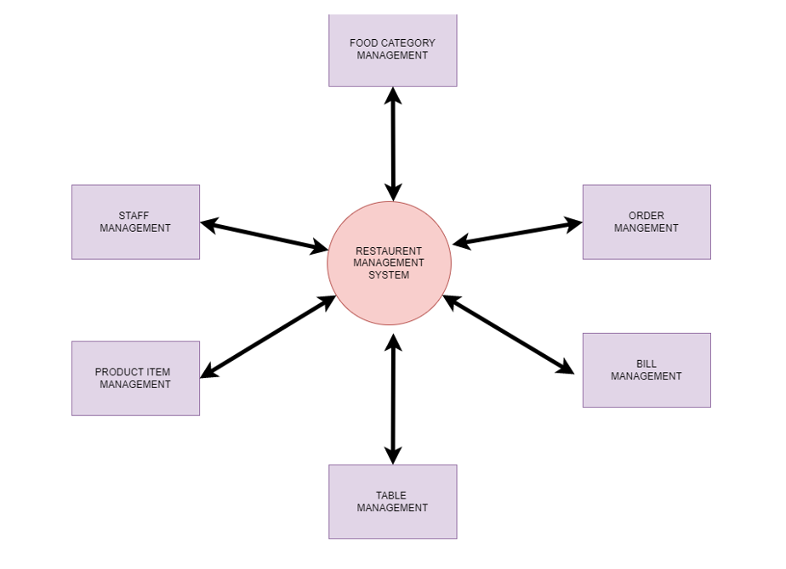
Functionality of Restaurant Management System

Slide 7
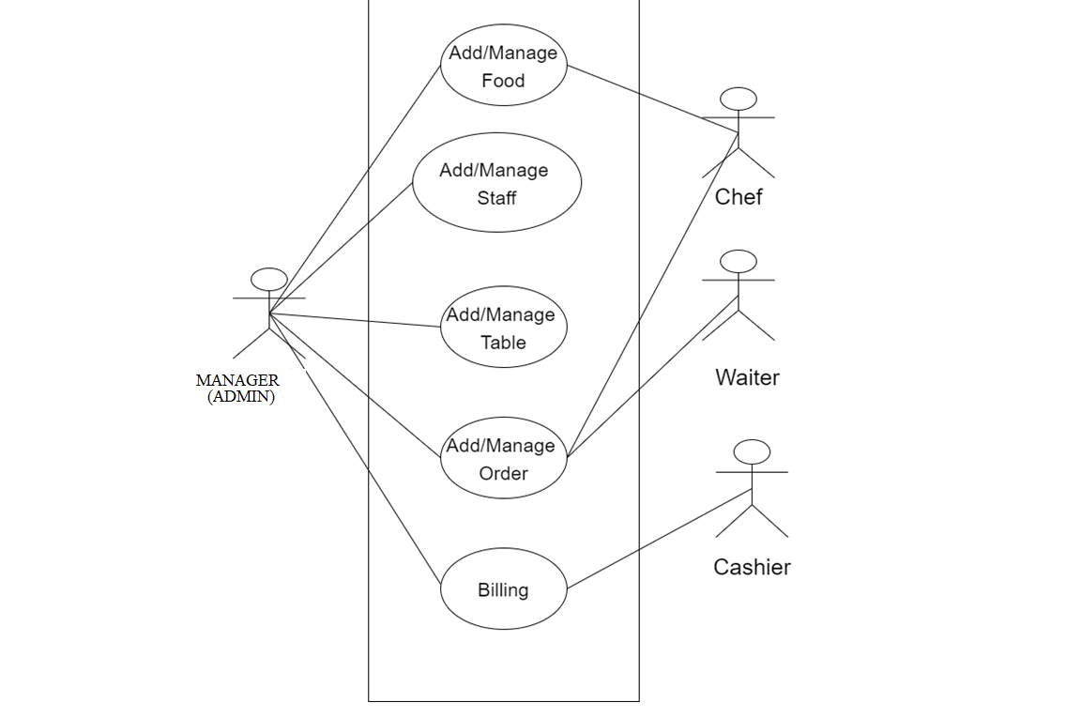
Use Case diagram for Restaurant Management System

Slide 8
MANAGER(ADMIN)
Every restaurant has a Manager. In our application, Manager is the Admin who has full access to the system and other privileges so that can he can well maintain the system workflow to ensure better and secure service.
What Manager can Do -
Assign waiter to the table
Add new job seeker for a specific job role
Add new food categories and food item under that category
Enable/Disable the staff member who is present or not present accordingly
Enable/Disable food items according to availability
Can change profile details

Slide 9
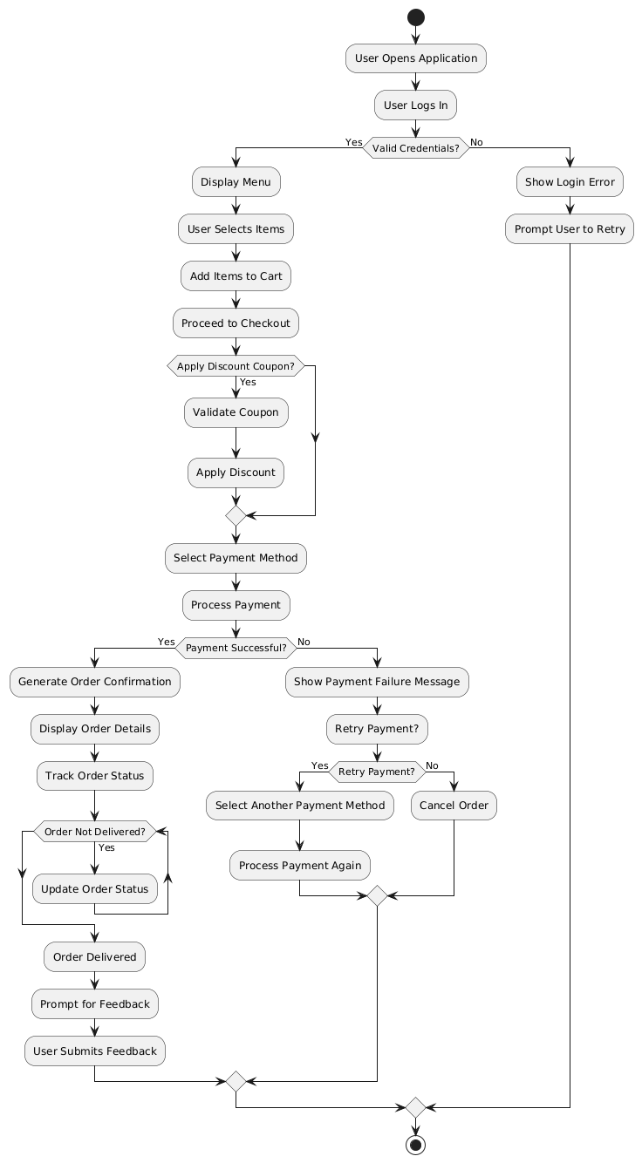
Activity diagram for Manager(ADMIN)

Slide 10
Chef(Staff Person)
The chef can see the orders of customers and check whether this order can be taken or not according to availability and then confirms the order and starts preparing the food. When the food is ready the chef alerts the waiter to serve the food.
What Chef can Do –
Add/Remove the Food Category
Add/Remove the Food items under the available category
Confirm/Reject the food order received from the waiter
Can change profile details

Slide 11
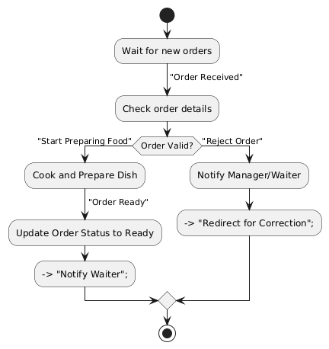
Activity diagram for Chef

Slide 12
Waiter(Staff Person)
A waiter can be assigned to multiple tables and will take orders from that particular table to which he is assigned which are booked by customer. Waiter can see the food order list and he will deliver the ready to serve food order as approved by the chef.
After serving the food the waiter will mark the order as served.
What Waiter can Do –
Choose the food items ordered by customer from specific table name
After order gets approved by chef, after serving the order he will mark the order as “Served”
Can change profile details

Slide 13
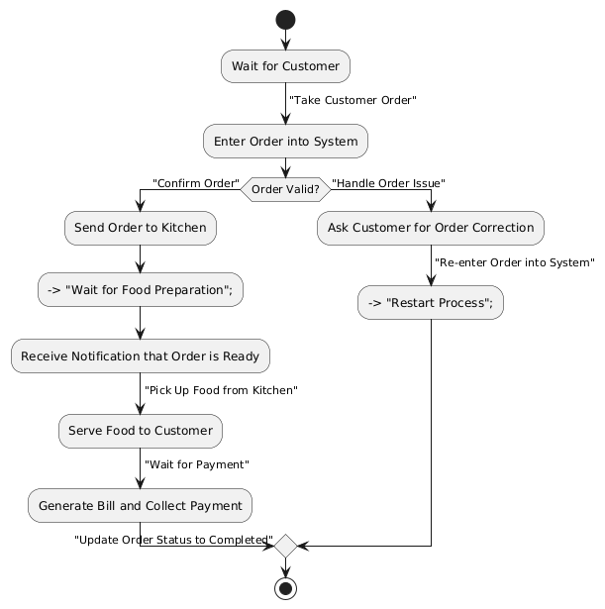
Activity diagram for Waiter

Slide 14
Cashier(Staff Person)
The Cashier can only take payment from the customer and save it into the system database with respect to the food items he ordered and also check if the customer is could be given discount(if any), if yes then take the payment accordingly.
What Chef can Do –
Receive payment
give discount(if any)
Can change profile details

Slide 15
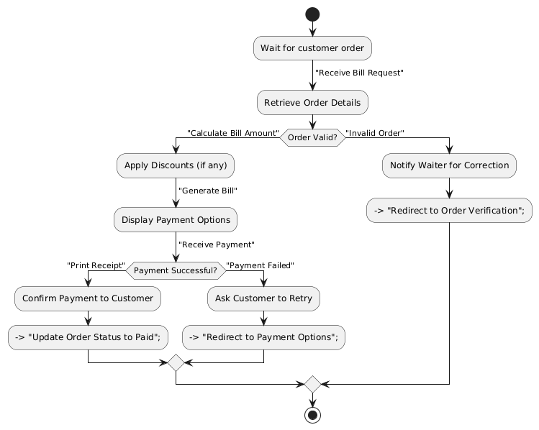
Activity diagram for Cashier

Slide 16
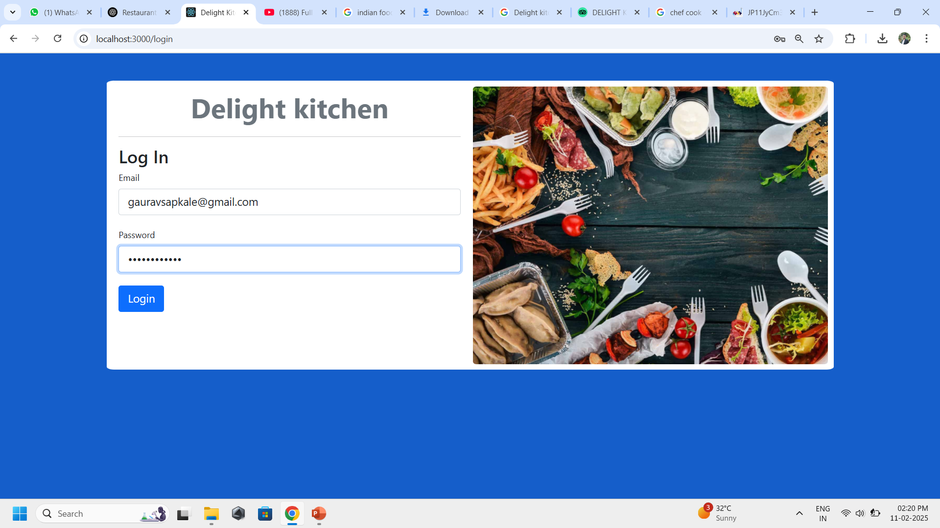
LOGIN SECTION FOR MANAGER

Slide 17
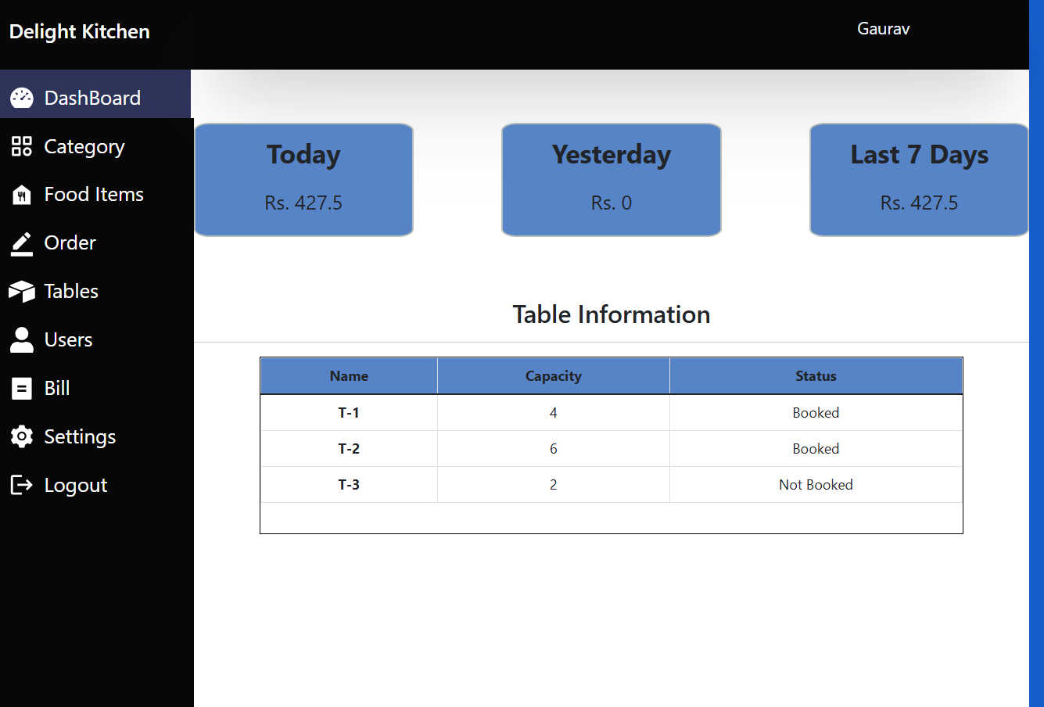
DASHBOARD OF MANAGER

Slide 18
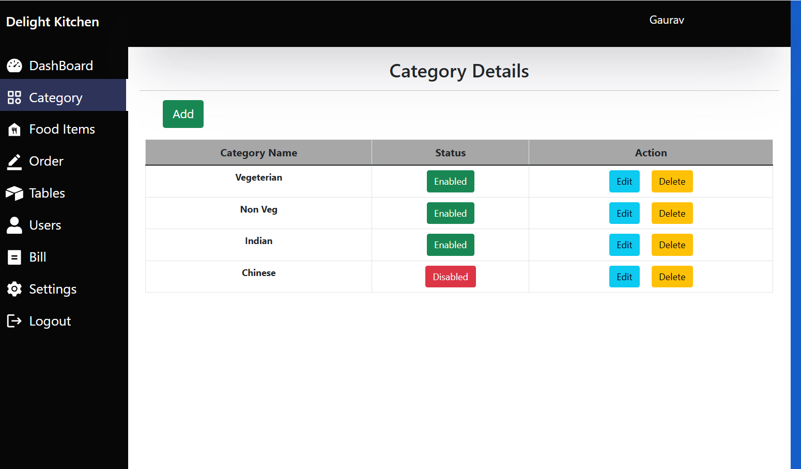
HERE GAURAV IS THE MANAGER OF DELIGHT KITCHEN RESTAURANT

Slide 19
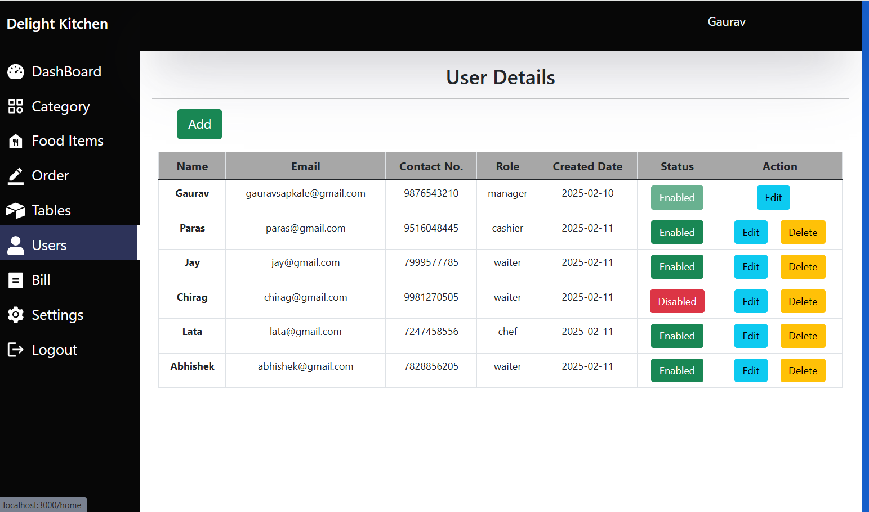
STAFF OF RESTURENT WHO CAN HAVE A ACCESS OF APPLICATION

Slide 20
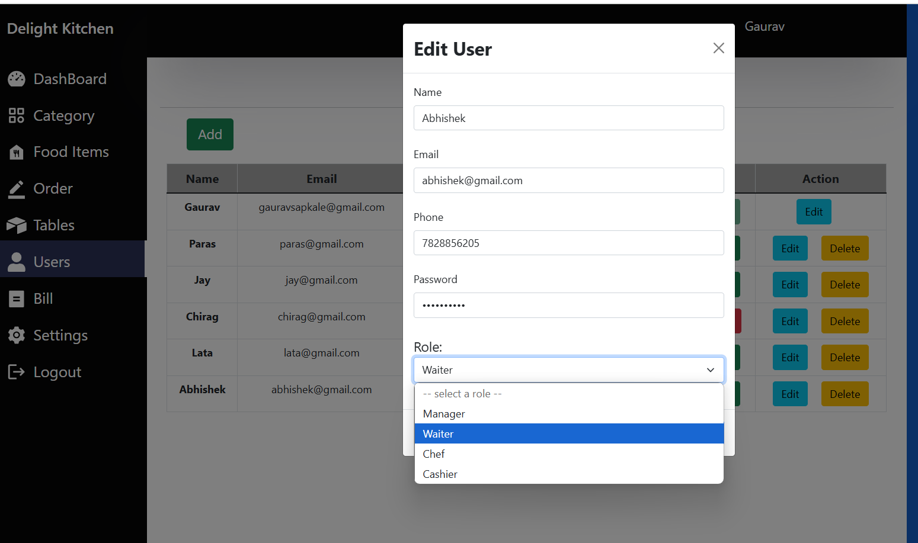
ADDING NEW STAFF (CASHIER) BY MANAGER

Slide 21
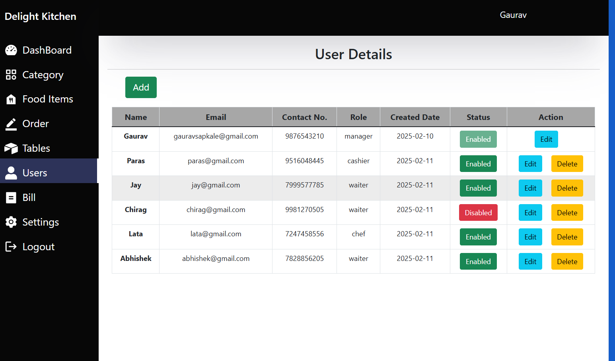
NEW STAFF (CASHIER) ADDED BY MANAGER

Slide 22
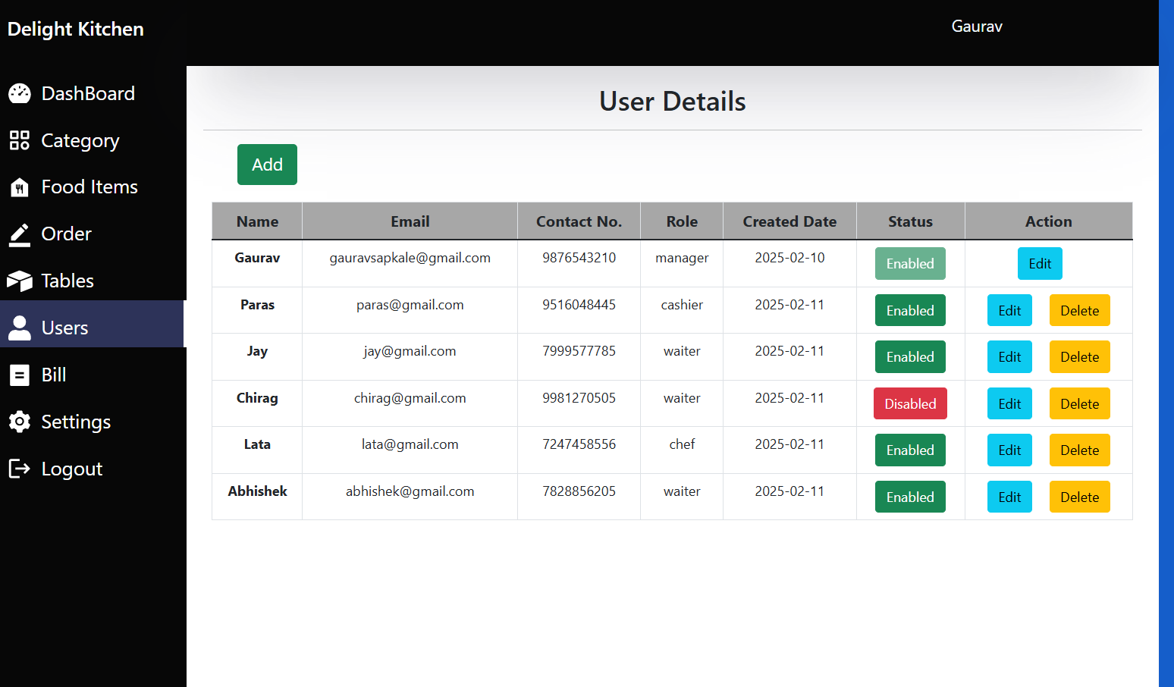
MANAGER CAN TEMPERORY DISABLED/ENABLED STAFF

Slide 23
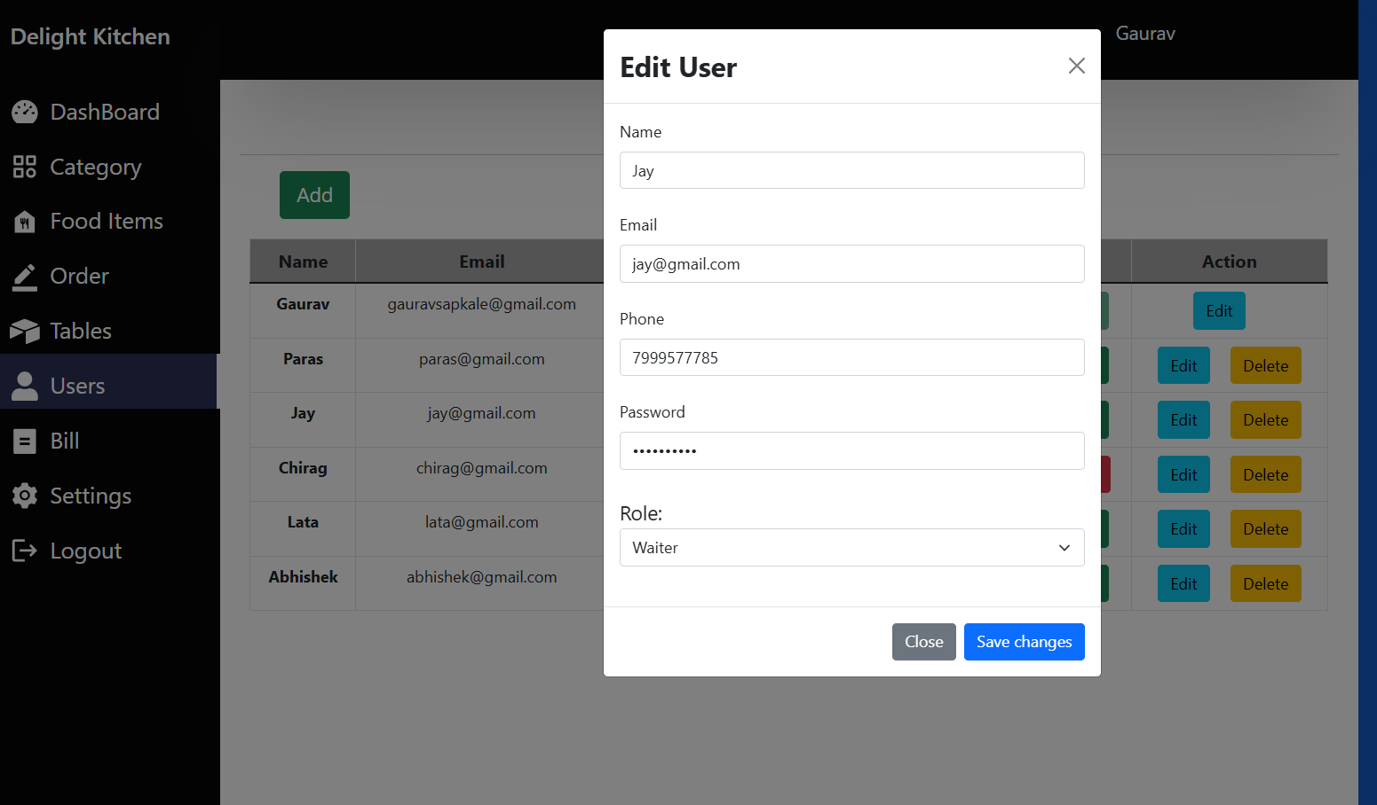
DETAILS OF STAFF UPDATED/EDITED AND DELETED BY MANAGER ONLY

Slide 24
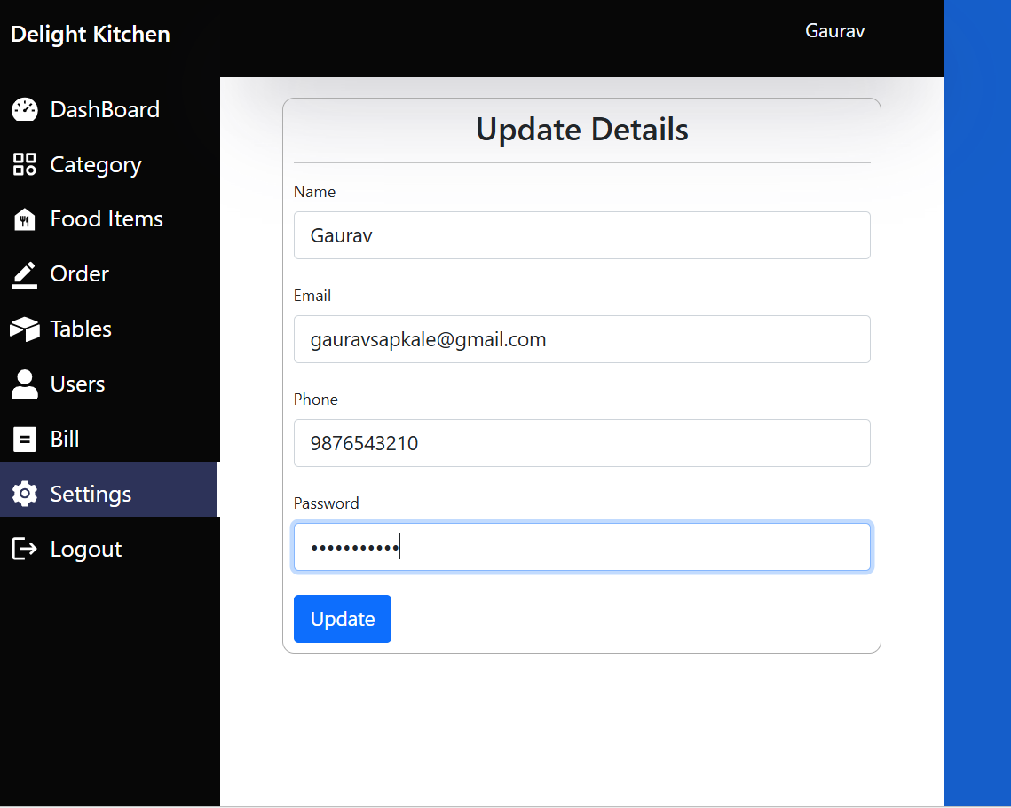
MANAGER CAN UPDATE HIS PASSWORD OR DETAILS ALSO FROM SETTINGS SECTION

Slide 25
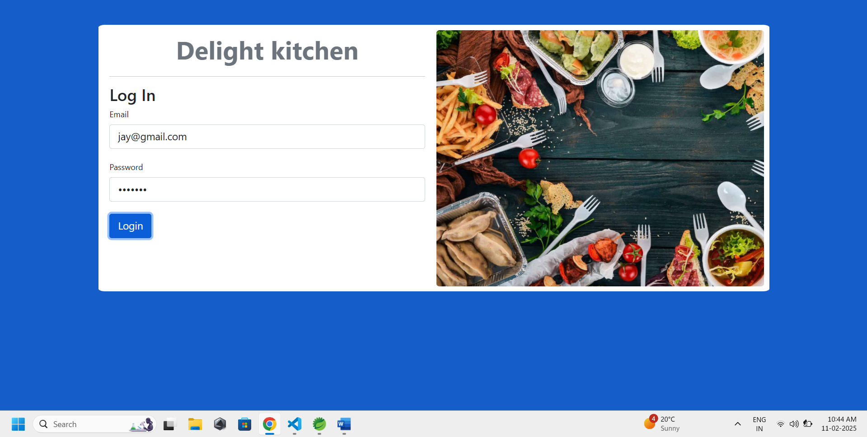
NOW ENTERED NEW CREDENTIAL TO LOG IN AS MANAGER

Slide 26
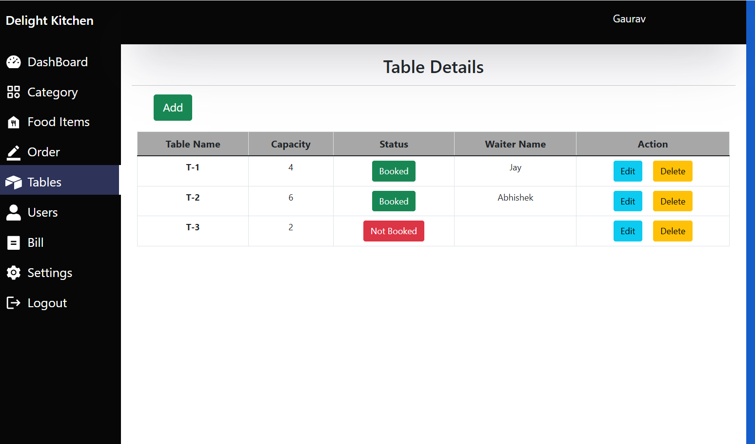
TABLES SECTION WHERE MANAGER CAN ASSIGN TABLES TO WAITERS

Slide 27
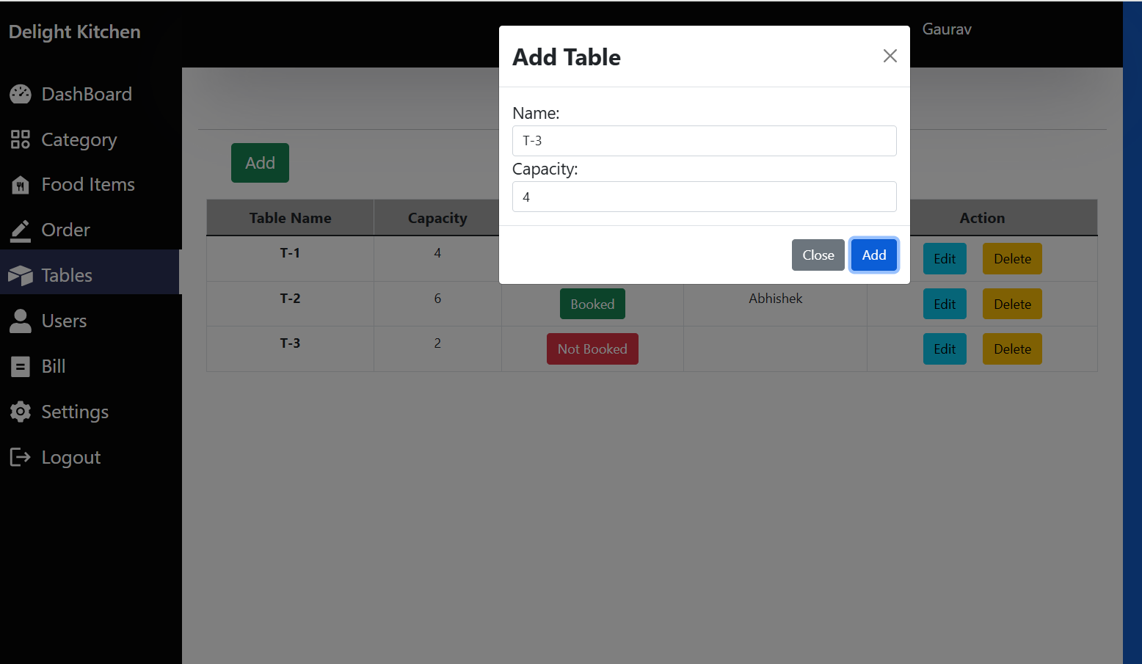
ADDING NEW TABLES WITH CAPACITY BY MANAGER

Slide 28
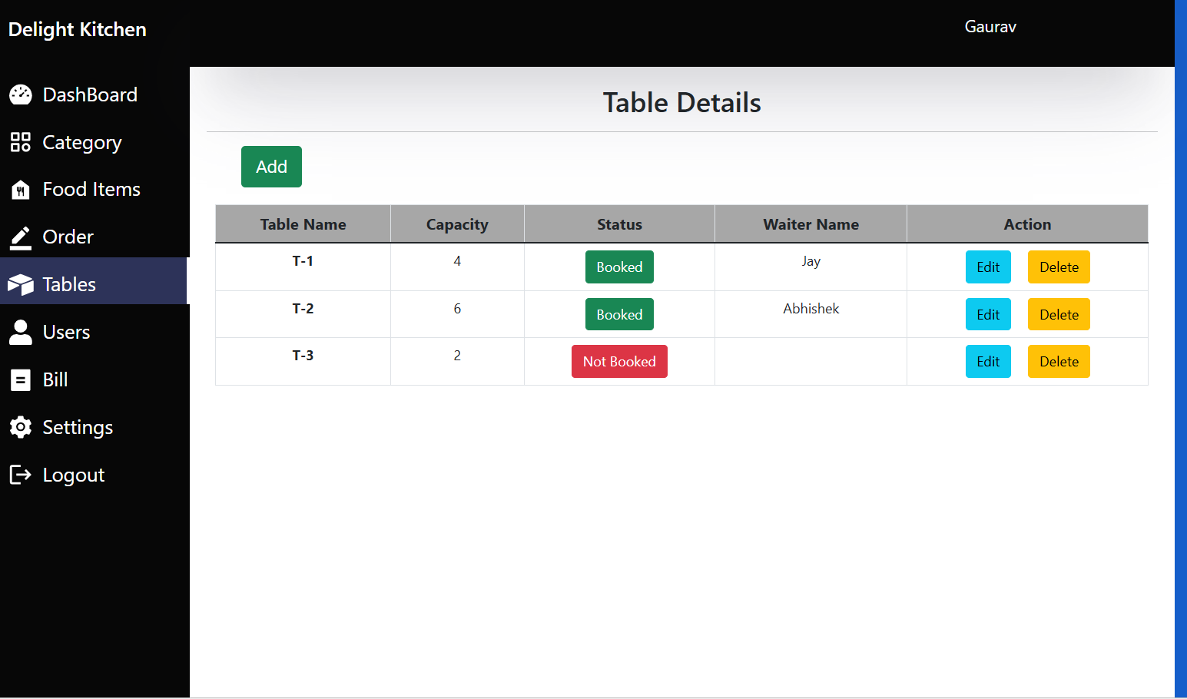
NEW TABLE T-3 ADDED BY MANAGER Which Is Not Assigned Yet To Any Waiter

Slide 29
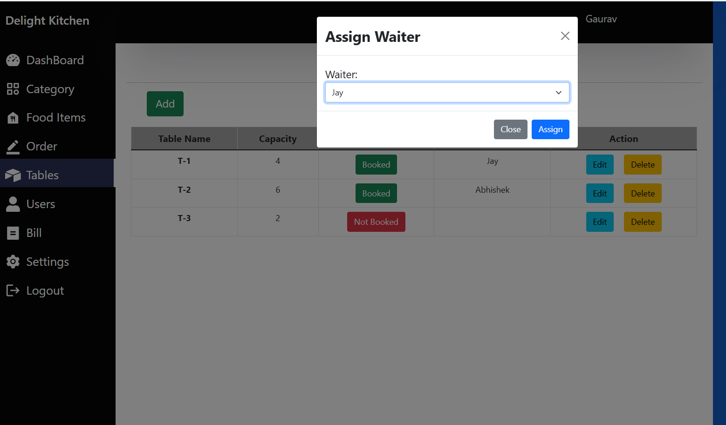
TABLE ASSIGNED BY MANAGER TO WAITER

Slide 30
NOW LOGIN BY WAITER

Slide 31
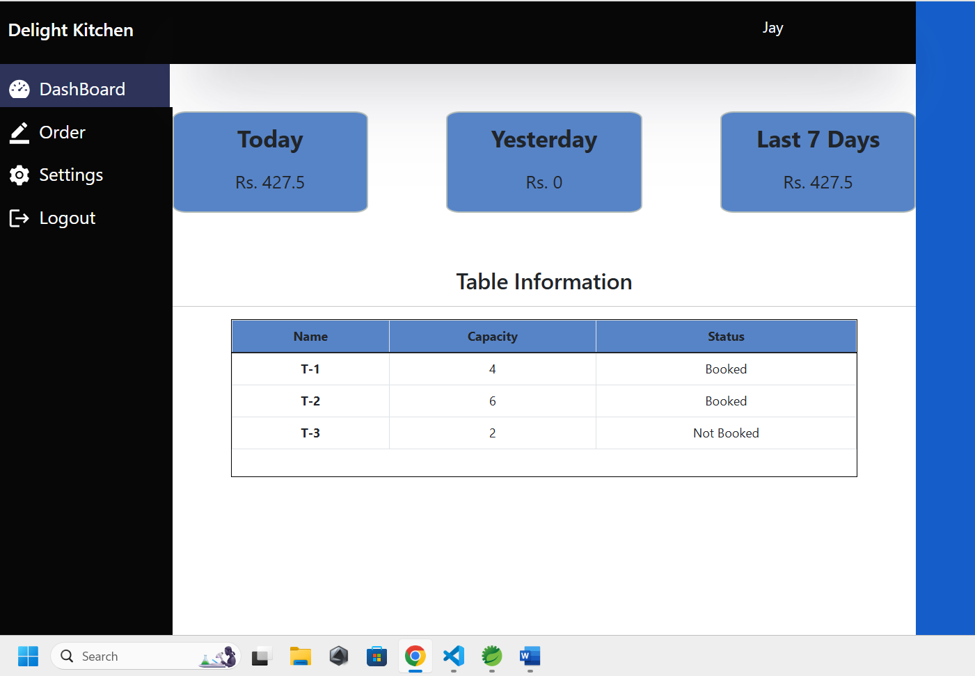
USER INTERFACE OF WAITER

Slide 32
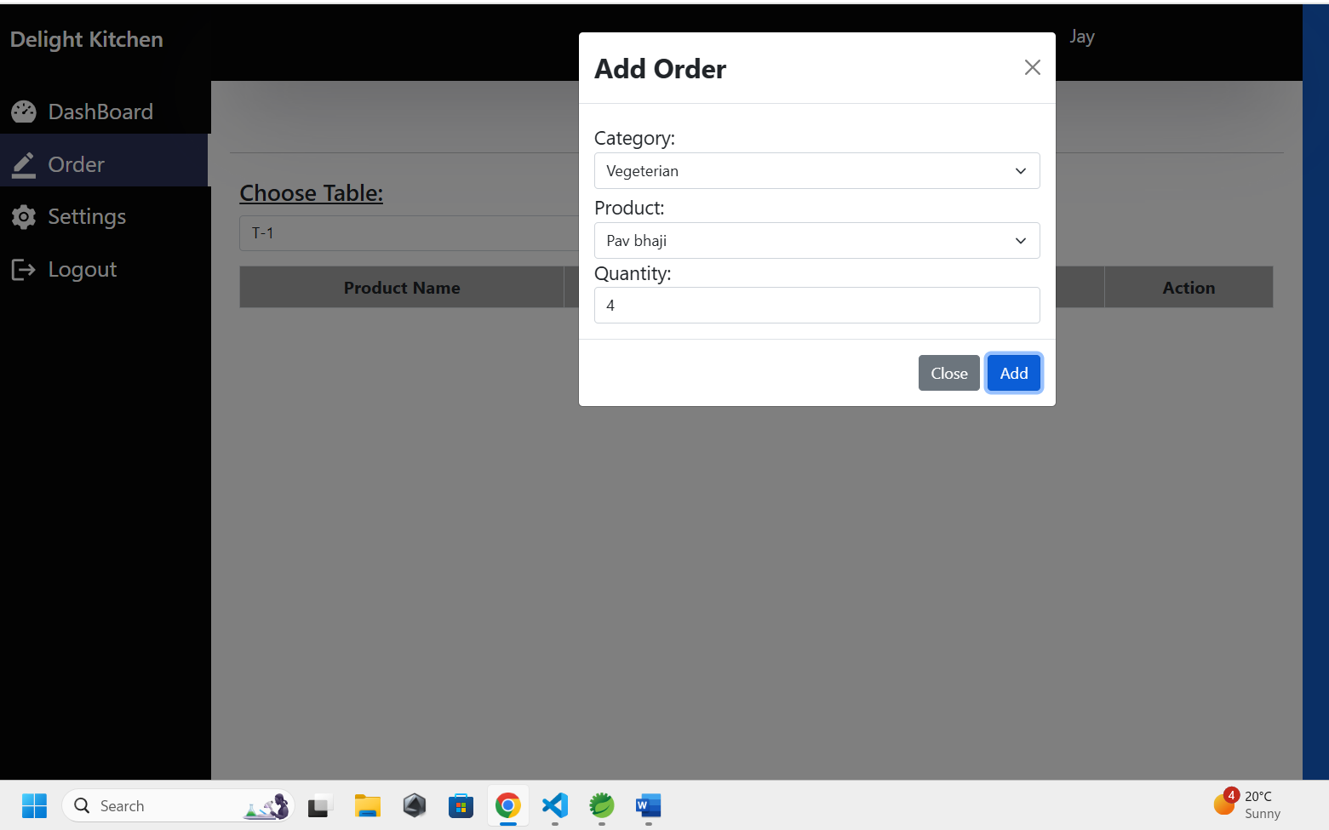
ORDER TAKING BY WAITER OF T-1 TABLE CUSTOMERS

Slide 33
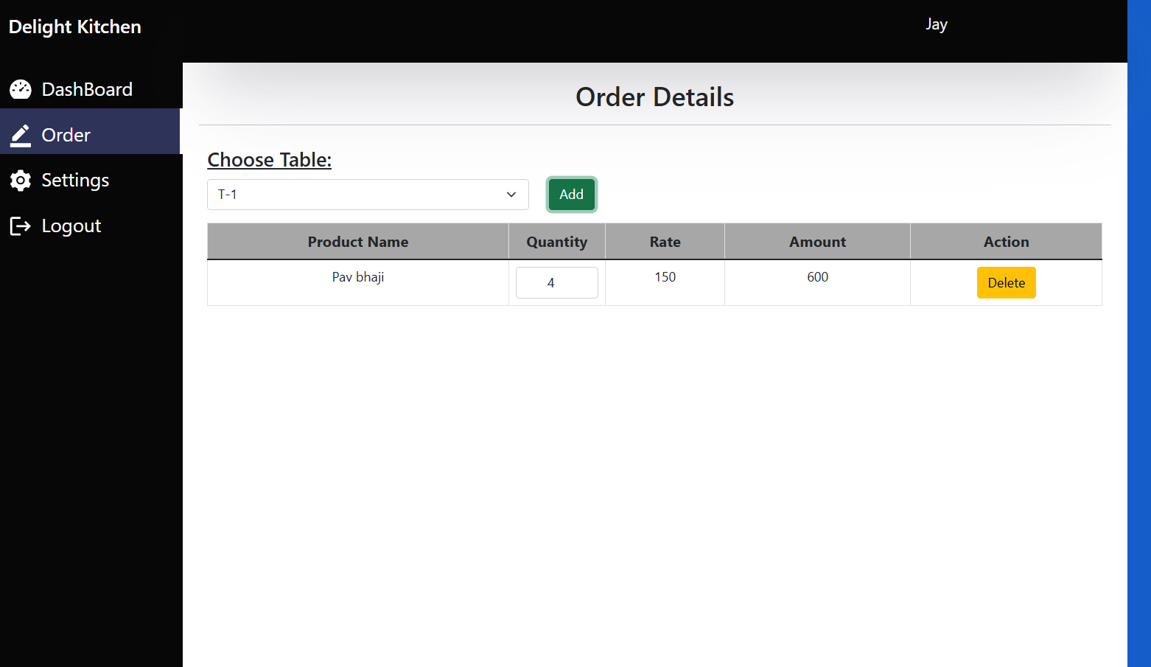
ORDERS TAKEN BY WAITEER FROM T-9 TABLE WHICH WILL BE HANDELED BY CHEF

Slide 34
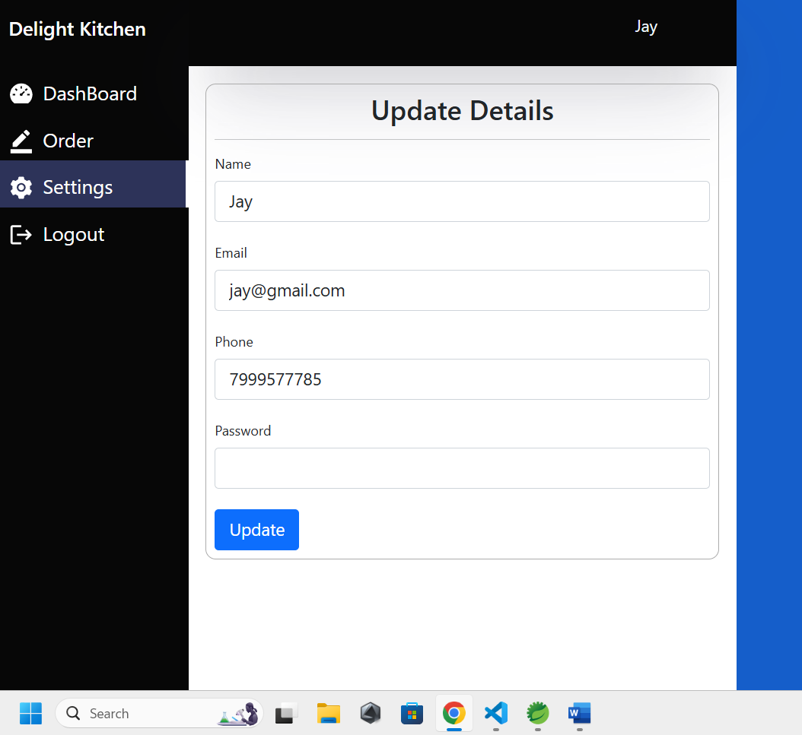
WAITER CAN CHANGE HIS PASSWORD , NAME OR USERID FROM SETTING SECTION

Slide 35
CHEF CAN SEE PENDING ORDER LIST

Slide 36
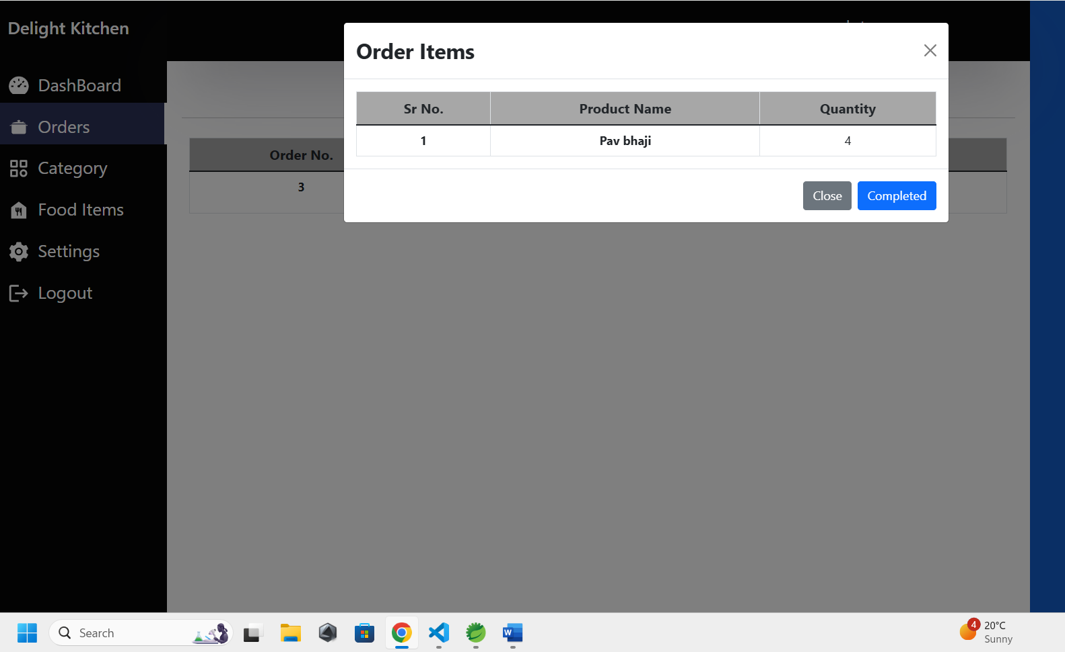
CHEF CAN MANAGE APPROVE/ COMPLETE ORDER

Slide 37
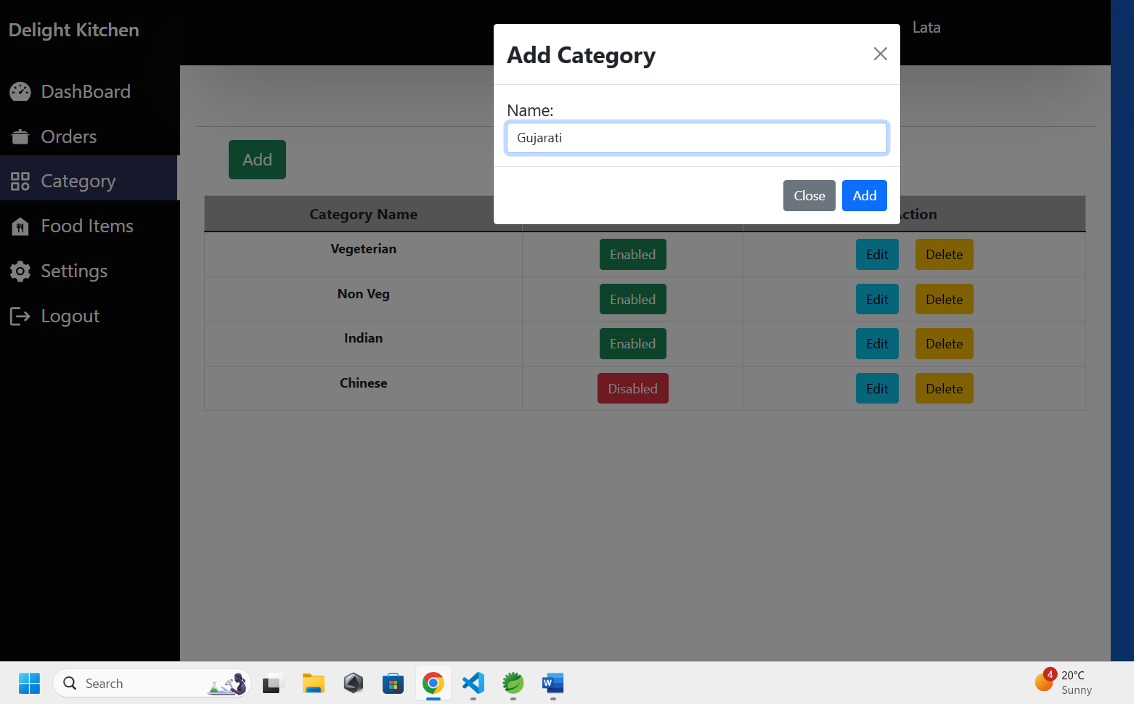
CHEF CAN ADD/DELETE/DISABLE/ENABLE /EDIT FOOD CATEGORIES

Slide 38
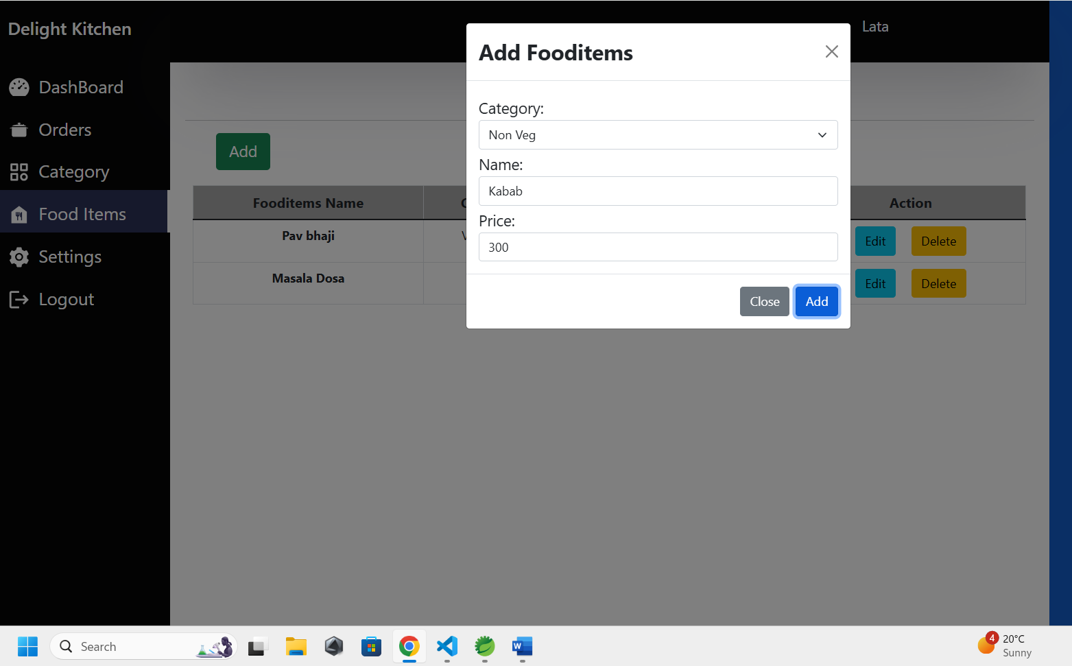
CHEF CAN ADD/DELETE FOOD PRODUCT

Slide 39

PARAS LOG IN AS A CASHIER USING CREDIENTIAL

Slide 40
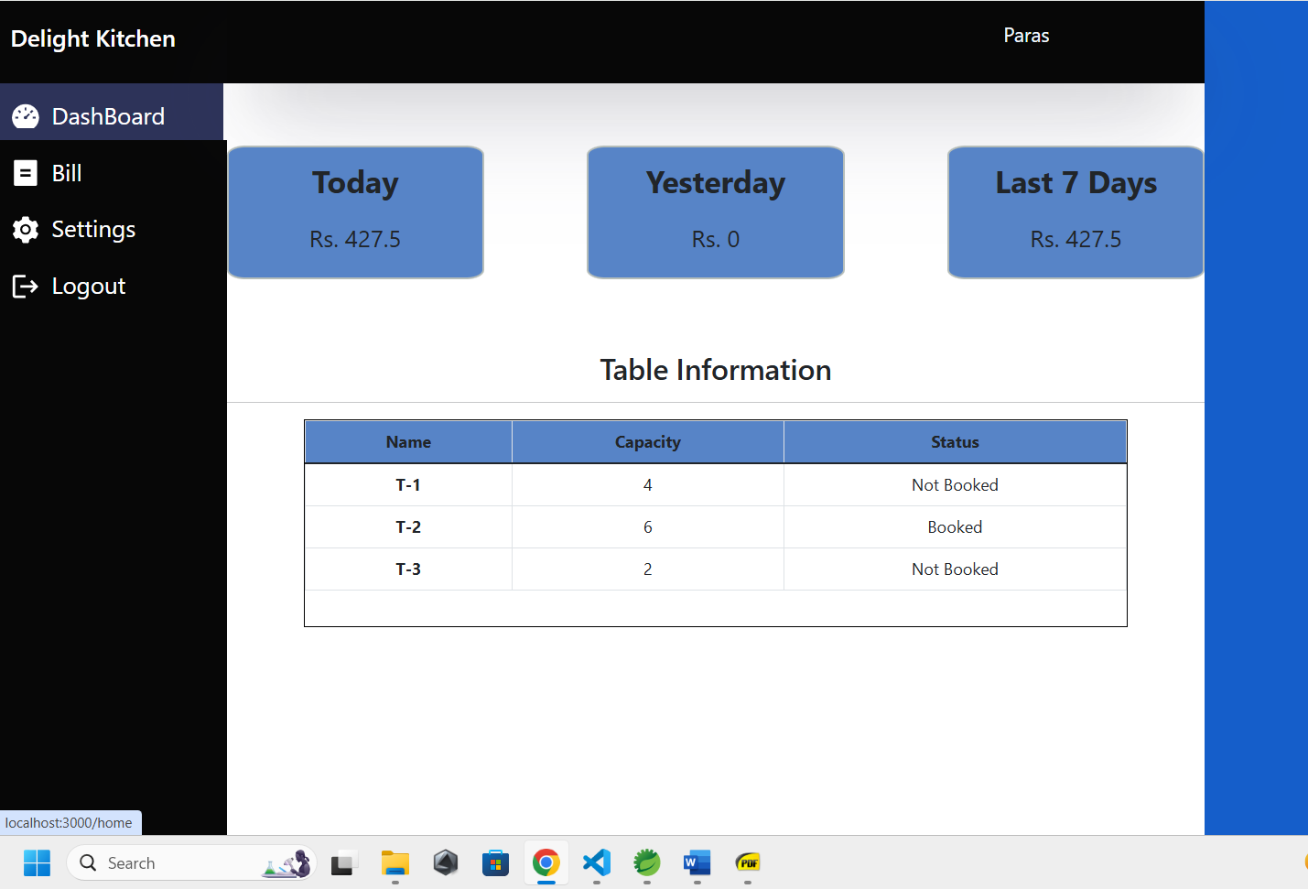
DASHBOARD OR UI OF CASHIER

Slide 41
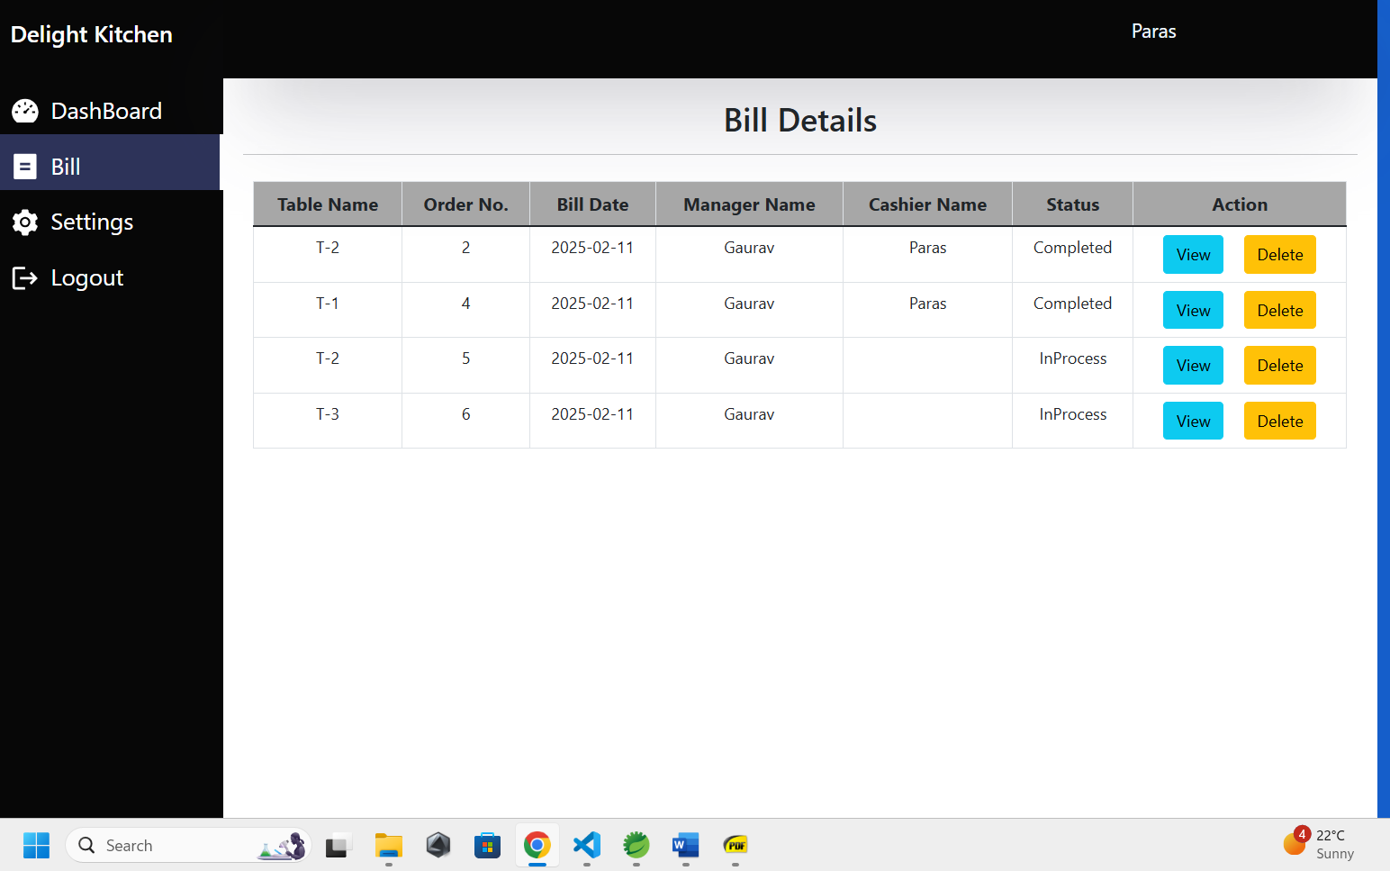
CAHIER CAN VIEW COMPLETED AND PENDING PAYMENT BILLS

Slide 42
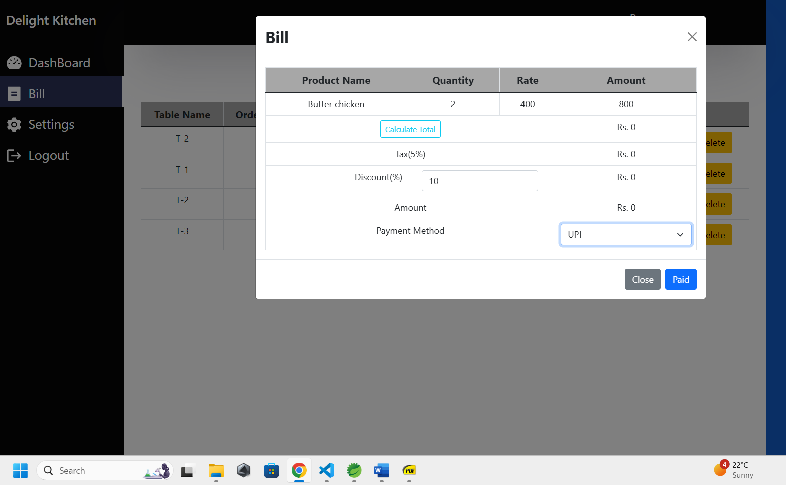
CAHIER CAN GENERATE BILLS AND CAN APPLY DISCOUNDS AND TAXES TO0

Slide 43
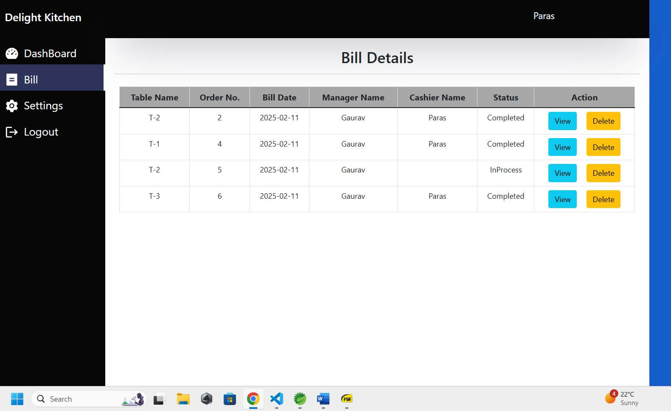
Payment done and order is completed

Slide 44
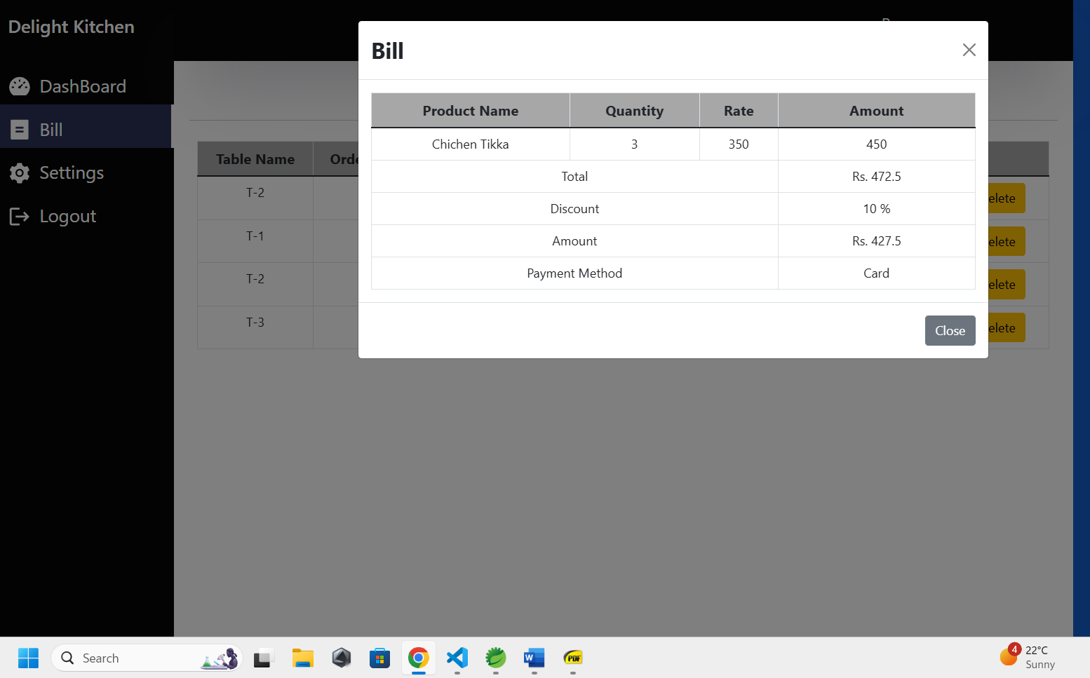
CAHIER CAN SEE PAYMENT HISTORY AND COMPLETED BILLS

Slide 45

PAYMENT REFLECTED IN DASHBOARD AFTER COMPETING PAYMENT
DASHBOARD SHOWS TODAYS ALL ORDERS IN RS

Slide 46
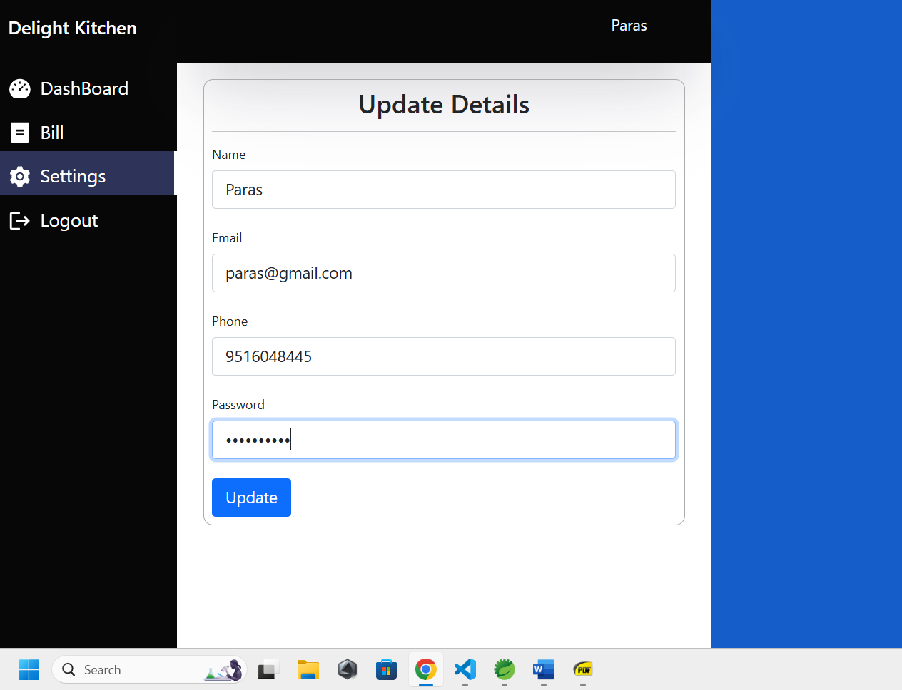
CAHIER CAN ALSO CHANGE HIS PASSWORD / NAME / USERID

Slide 47
Thank You!!

